Slide 1



Data
Governance
with EQuIS® in the age of artificial intelligence
​
Risk management, quality controls,
& audit-ready environmental data​
Copyright EarthSoft Inc. 2026
earthsoft.com

Slide 2



Authors
Dan McCarthy is the Senior Account Strategist, and Alek Hage​ serves as the Technical Advisor for the EarthSoft Commercial Business Team.
Dan McCarthy
Senior Account Strategist
Alek Hage​
Technical Advisor
Copyright EarthSoft Inc. 2026
earthsoft.com

Slide 3

Disclaimer
The infographics shown in this presentation were created using commercially available image generation models based on prompts written by
the authors.
Concepts discussed related to the EQuIS product line are not associated with a particular version or build of EQuIS, are presented as “proof of concept” only and the look and feel is subject to change.
Copyright EarthSoft Inc. 2026
earthsoft.com

Slide 4
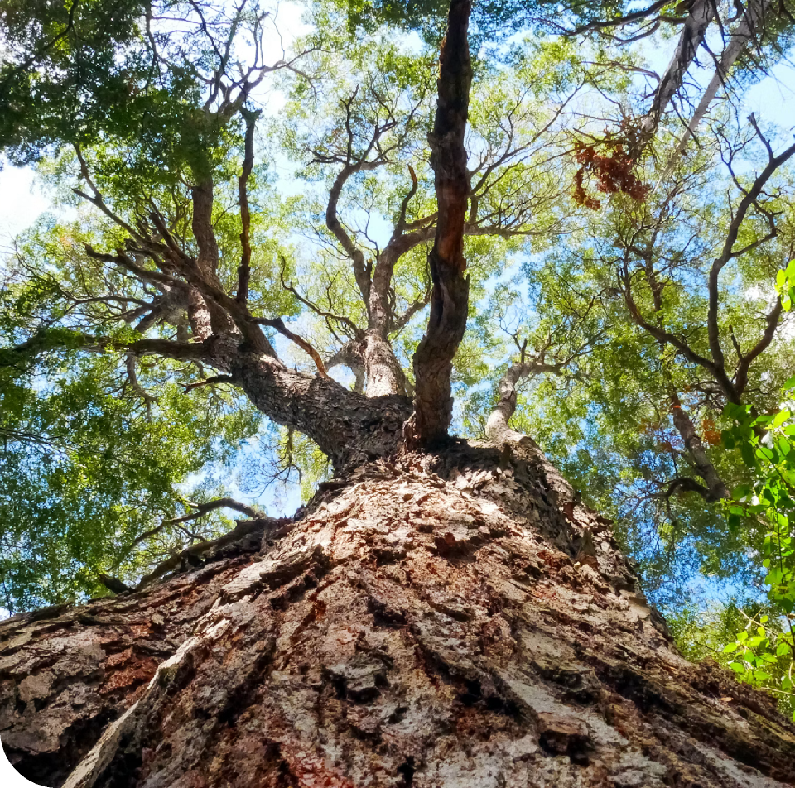
Agenda​
‣ Context ​
‣ Definitions ​
‣ System of Record
‣ Risk and Controls ​
‣ Operate and measure​
‣ Practical Examples​
‣ Key Takeaways​
Copyright EarthSoft Inc. 2026
earthsoft.com

Slide 5


Context

Slide 6
AI landscape is changing rapidly
Good
Bad
Vibe Physics – AI derives new results in theoretical physics​
States across the wildfire-prone Western US are using AI for early detection
An AI agent deleted a software company’s entire database
Meta Superintelligence safety director lost control of her AI agent—it deleted her emails
Governance is the scaffolding that separates the bad from the good outcomes.
Copyright EarthSoft Inc. 2026
earthsoft.com

Slide 7
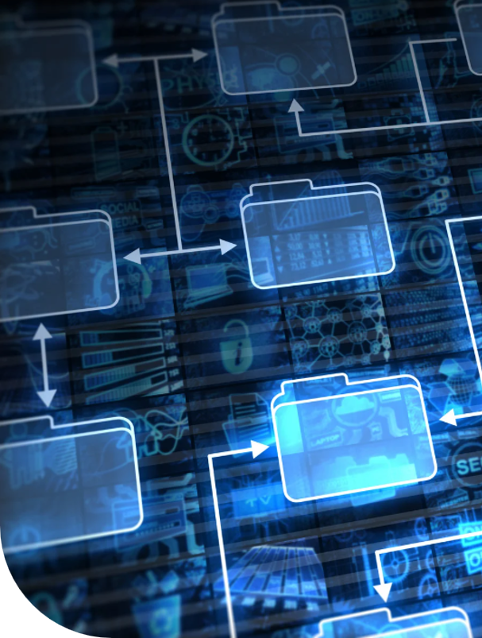

Why data governance matters​
WHAT CHANGED​
What is different in the AI era​
AI amplifies data issues: Small errors (mis-labeled locations, wrong units, missing qualifiers, inconsistent detection limits) cascade in predictions, prioritization, automated reporting—impact scales beyond single report.​
New consumption patterns: Data feeds dashboards, models, copilots, workflows; consistent structure/definitions required; ambiguity is operationally expensive across teams/tools.​
Faster decisions & higher scrutiny: Near-real-time field/lab insights risk premature use of unverified data unless controls are embedded; AI-assisted conclusions trigger tougher questions; traceability becomes governance requirement.​
Copyright EarthSoft Inc. 2026
earthsoft.com

Slide 8
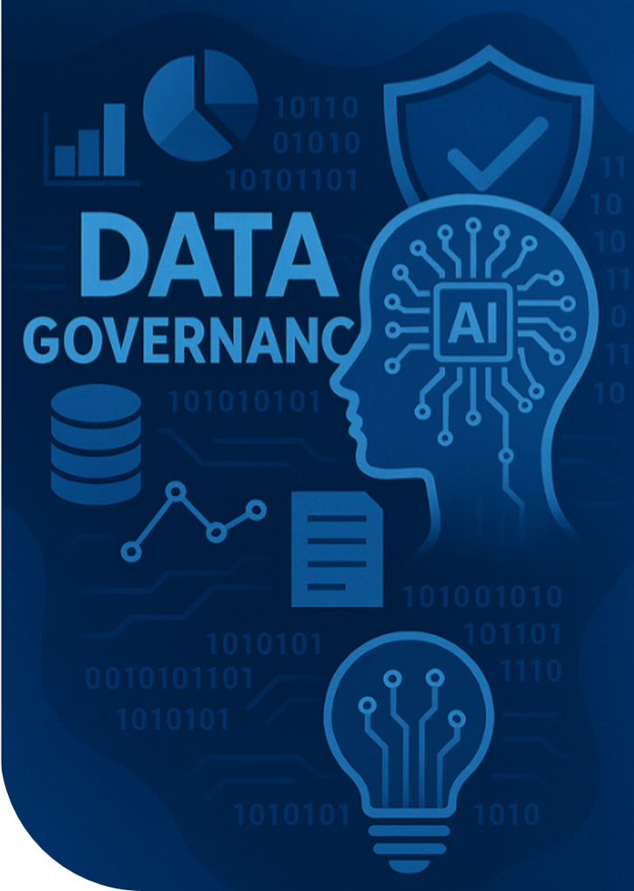
Why data governance matters​
WHY GOVERNANCE IS THE ANSWER​
How governance addresses the risk​
Shared definitions and accountability: Clarifies ownership (data stewards, approvers) and standardizes definitions (sites, samples, results, qualifiers), reducing misinterpretation across people, systems, and AI tools.​
Fit-for-purpose controls: Aligns controls to risk (e.g., stricter for compliance reporting than exploratory analytics), avoiding both over-control that slows delivery and under-control that creates exposure.​
Repeatable evidence: Creates a consistent trail of validation, approvals, and changes so AI outputs can be defended with documented inputs, lineage, and process.
Safer AI enablement: Governed data enables discovery and automation while reducing the likelihood of erroneous outputs, rework, and non-defensible conclusions.​
Copyright EarthSoft Inc. 2026
earthsoft.com

Slide 9
Definitions

Slide 10

The vocabulary of AI​
LLM: A large language model (LLM) is a probabilistic model that manipulates natural language with a large number of parameters (typically at least a billion) that are adjusted during training. Examples are GPT5.4 (OpenAI), Opus 4.7 (Anthropic), and Gemma4 (Google).
Prompt: A prompt is an instruction entered into a system in language, images, or code that tells the AI what task to perform. All of us who interact with AI systems must carefully design prompts to get the desired outcome from the large language models.
Agent: An agent is a software program that exhibits one or more of the following characteristics:
Persistence: Code is not executed on demand but runs continuously and decides for itself when it should perform some activity.
Autonomy: Agents have capabilities of task selection, prioritization, goal-directed behavior, decision-making without human intervention.
Social ability: Agents can engage other components through some sort of communication and coordination; they may collaborate on a task.
Reactivity: Agents perceive the context in which they operate and react to it appropriately.
Hallucination: A response generated by AI that contains false or misleading information presented as fact.
Copyright EarthSoft Inc. 2026
earthsoft.com

Slide 11
System
of Record​

Slide 12

EQuIS️ ® as the system of record​
‣ Field data
‣ Lab data
‣ Telemetry
‣ Derived data sets
‣ Unstructured data
Copyright EarthSoft Inc. 2026
earthsoft.com

Slide 13


Metadata, lineage, & auditability in EQuIS​®
Essential metadata for reuse
Environmental data reuse requires metadata: who collected, what sampled, when/where, how produced; context, methods, detection limits, qualifiers, units, coordinate systems, reference frames.​
Lineage for reproducibility​
Lineage must show source file/package, transformations, validation rules (triggered/waived), reference data version (locations, analytes, units, methods) for repeatable, defensible results.​
Auditability beyond logs​
Auditability links people, decisions, data changes: who approved, edited, what changed, why. Narrative must be explainable for regulators/auditors, not just technically traceable.​
Reducing AI hallucination risk​
Strong metadata/lineage reduce AI hallucination risk by grounding models/users in explicit context. Traceable inputs, standardization, validation, authoritative records enable provenance and constraint-based analytics.​
Copyright EarthSoft Inc. 2026
earthsoft.com

Slide 14
Risk &
Controls​

Slide 15


AI risk landscape: Environmental data failures​
HIGH LIKELIHOOD
LOW LIKELIHOOD​
High impact (top-left quadrant)​
High impact (top-right quadrant)​
Unit and method inconsistencies (e.g., mg/L vs µg/L; different lab methods) can create misleading trends and trigger incorrect exceedance flags.​
Location identity issues (duplicate names, incorrect coordinates, changing IDs) can cause models to blend distinct monitoring points or split the same point into multiple entities.​
Silent schema drift (new qualifiers, changed code lists) can break automated transformations, producing wrong joins or dropped records that are hard to detect in AI pipelines.​
Unauthorized use of sensitive data (e.g., confidential site details) can appear in model outputs and become widely shared.​
Low impact (bottom-left quadrant)
Low impact (bottom-right quadrant)​
Missing metadata (sampling depth, matrix, time zone) forces assumptions; AI fills gaps with defaults that may not match program intent.​
OCR/ingestion artifacts from legacy PDFs or spreadsheets can introduce subtle transcription errors that persist across downstream analytics.​
Minor formatting differences reduce automation efficiency but are typically caught in manual review.​
.​
Governance reduces these risks by standardizing reference data, enforcing validation gates, maintaining lineage, and controlling who can use what data for which AI purpose.
Copyright EarthSoft Inc. 2026
earthsoft.com

Slide 16
Operational playbooks for field teams​
Playbooks reduce downstream rework and AI risk by blocking ambiguous inputs​
DO
WATCH FOR​
ESCALATE
Assign a unique sample ID before collection. Label container with waterproof ink and bag immediately. Cross-check ID against the form and photo before leaving the site.​
Confirm instrument units at start of event
(e.g., mg/L vs µg/L) and record them. Use the approved rounding rules. Flag readings that change unit or scale mid-series.​
Escalate at once for unusual results,
missing chain-of-custody, or suspected location mismatch. Stop analysis, isolate the sample, and notify the field lead with IDs and timestamps.
DO
WATCH FOR​
ESCALATE
Capture required metadata every time: depth, matrix, collection time, and method. Use picklists when available. If unknown, record “unknown” and explain—never leave blanks.​
If a record needs correction, add a new entry and reference the original. Never overwrite values without a trace. Document what changed, why, who approved, and when.​
Keep notes and photos free of sensitive data (faces, IDs, addresses). Redact before upload and store originals securely. If exposure is possible, escalate to the data steward.​
Copyright EarthSoft Inc. 2026
earthsoft.com

Slide 17

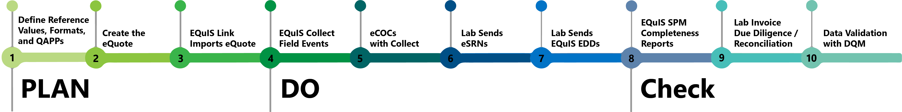
Laboratory data quality controls​
FIELD TO REPORTING​
Quality is not one gate at the end; it is a chain of controls that produces evidence at every step. This end-to-end evidence trail (checks performed, exceptions resolved, approvals recorded) is what makes downstream analytics and AI outputs defensible.​
Copyright EarthSoft Inc. 2026
earthsoft.com

Slide 18
Operate
& Measure​

Slide 19
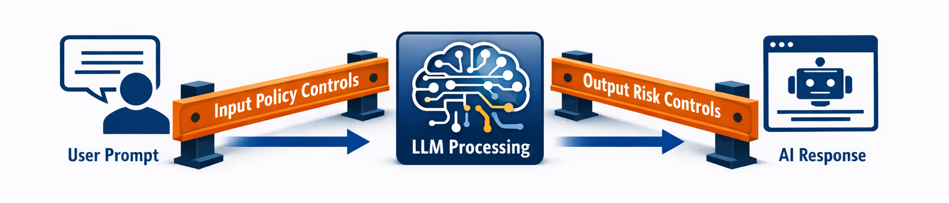
Guardrails for reporting​
Direct end users to “prompt responsibly” ​
Recommendations unless validated; QA/evidence for reporting / regulatory submissions
Content Filtering
Format Validation
Domain-Specific Rules
PII Redaction
Consistency and
Fact Checks
Intent Classification
Topic Boundaries
Copyright EarthSoft Inc. 2026
earthsoft.com

Slide 20
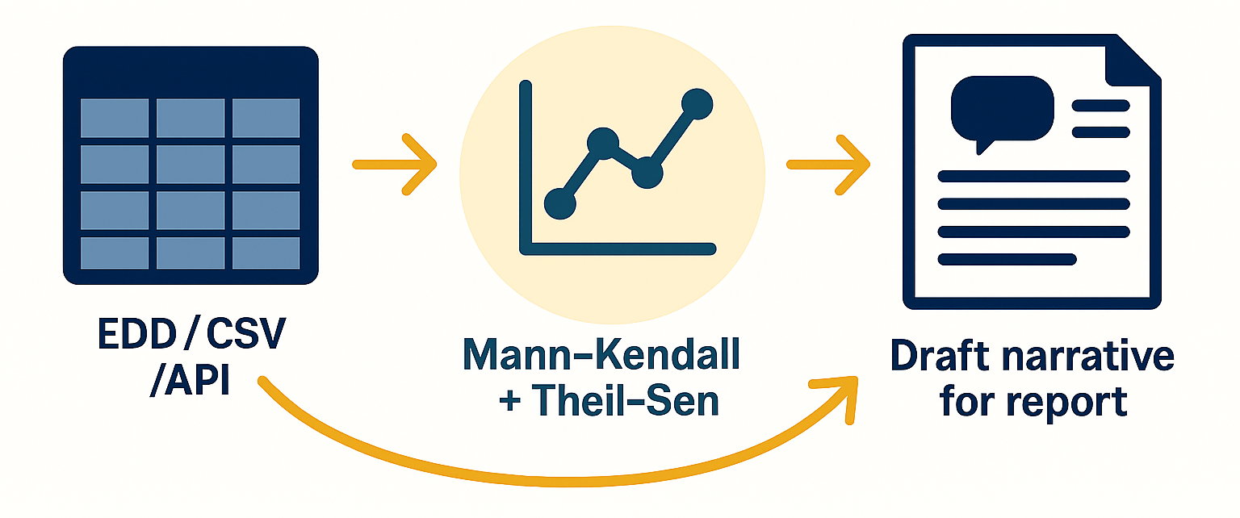
A Mann-Kendall non-parametric trend analysis with Theil-Sen slope estimation was performed on site-wide median concentrations of chlorinated volatile organic compounds (CVOCs) to evaluate long-term contaminant behavior in groundwater. Non-detect values were treated using a standard substitution method in which non-detects were assigned one-half of the associated method detection limit (MDL/2). This approach preserves relative concentration ordering and is appropriate for non-parametric trend assessment. To reduce the influence of individual well variability, results were aggregated to site-wide median concentrations for each sampling event.
The analysis indicates that parent chlorinated solvent compounds are decreasing in concentration over time, while daughter products are increasing, which is characteristic of active reductive dechlorination
under anaerobic aquifer conditions.
Specifically:
Trichloroethylene (TCE) and Carbon Tetrachloride exhibited statistically significant decreasing trends (Kendall Tau = -1.00; p = 0.0028), with Theil-Sen slope estimates of approximately -0.04 µg/L/day and -0.013 µg/L/day, respectively. These trends indicate ongoing natural attenuation or the effect of historical remedial actions.
The intermediate breakdown products cis-1,2-Dichloroethene (cis-DCE) and Chloroform exhibited statistically significant increasing trends (Kendall Tau = +1.00; p = 0.0028), consistent with expected transformation pathways during reductive dechlorination.
A cautionary tale…​
FIELD TO REPORTING​
Bench scale testing to:
Have the LLM ingest a report output from EQuIS.
Perform statistics on that data set.
Generate draft narrative language for inclusion in a monitoring report.
“doveryay, no proveryay” – Russian proverb. Translates to “trust but verify”
Copyright EarthSoft Inc. 2026
earthsoft.com

Slide 21


Compliance & audit readiness:
evidence, traceability, defensibility​
1
EVIDENCE
2
TRACEABILITY​
AUDIT PACKAGE​
Data intake & validation: Log received records/packages, when/by whom; file hashes, load lineage; persist rule set/version, failures, corrections, accepted output with exception notes.​
Approval: Capture reviewer, approval time, criteria; store rationale, links to supporting records.​
Lineage: Link each reported value to source records and transformation steps.​
Reference data: Show which units/analytes/locations version was effective at time of calculation.​
Change history: Show who changed a record, when, why, and the before/after values.
Bundle evidence exports, lineage views, and approval logs into a time-stamped package auditors can replay without manual reconstruction.​
3
DEFENSIBILITY (AI)​
Boundaries: Specify where AI helped (drafting, flags, classification) and what human review occurred.​
Snapshots: Keep the exact data extract used tied to decisions.
Disclosures: Ensure AI narratives trace to data and do not expose restricted information.
Copyright EarthSoft Inc. 2026
earthsoft.com

Slide 22




Metrics & continuous improvement: What to measure and review​
Balanced scorecard to monitor quality, timeliness, governance, and AI
MODEL GOVERNANCE​
GOVERNANCE & ACCESS​
Validation failure rate: Share failing checks​
Metadata completeness & Duplicate rate: Required metadata complete; avoids double counting​
Governed exports (#): Count of approved releases—tracks control​
Access review completion: % completed—confirms accountability​
Sensitive-access exceptions: Exceptions granted—spotlights policy gaps​
Audit log review coverage: % logs reviewed—detects misuse early
TIMELINESS​
AI SAFETY & EFFECTIVENESS​
Sampling-to-EQuIS time: Lab-to-system lag—drives SLA focus​
Exception resolution time: Time to clear failures—reduces backlog​
Reporting cycle time: End-to-end cycle enables timely decisions​
Curated dataset use: % AI cases curated—reduces hallucinations​
Human override rate: % outputs overturned—flags low trust​
Reproducibility success: Past analyses rerun—proves traceability​
REVIEW
CADENCE​
Review the scorecard monthly with metric owners. Use trends to tune validation rules, prioritize data remediation, and update training for labs and analysts. Escalate persistent breaches through governance forums, socialize corrective actions, and track closure. Keep definitions stable but adjust thresholds as processes mature.​
Copyright EarthSoft Inc. 2026
earthsoft.com

Slide 23
Practical Examples​

Slide 24

MCP – Model Context Protocol​
MCP (Model Context Protocol) is an open-source standard for connecting AI applications to external systems.
Using MCP, AI applications like Claude or ChatGPT can connect to data sources (e.g., local files, databases), tools (e.g., search engines, calculators) and workflows (e.g., specialized prompts)—enabling them to access key information and perform tasks.​
Think of MCP like a USB-C port for AI applications. Just as USB-C provides a standardized way to connect electronic devices, MCP provides a standardized way to connect AI applications to external systems.​
Since EarthSoft is partnered with Microsoft, Azure AI Foundry is the initial toolset we are working with to explore the MCP framework.​
Copyright EarthSoft Inc. 2026
earthsoft.com

Slide 25
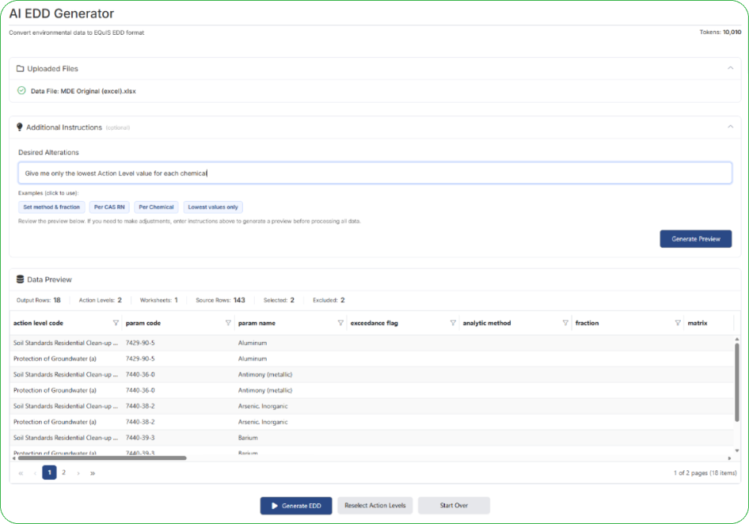
EDD Generator
Users can upload source data, add a few simple instructions (for example, picking the lowest action levels per chemical), and the tool automatically turns it into an EQuIS-ready EDD.
For now, this will only support Action Level format but can be extended to others as well in the future. ​
Copyright EarthSoft Inc. 2026
earthsoft.com

Slide 26
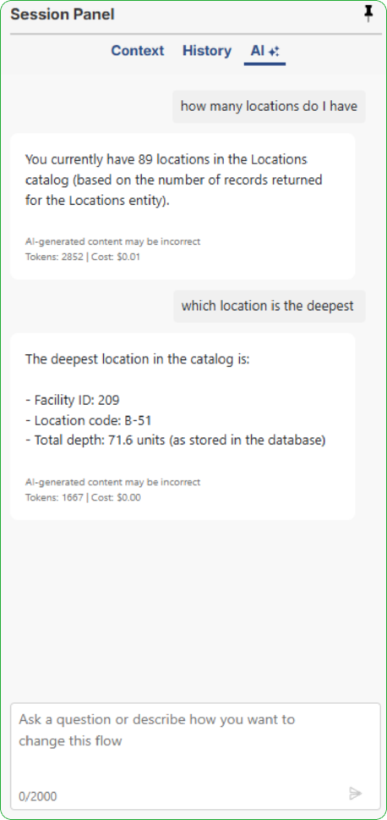
Natural Language Query​
A user submits a natural-language query.​
The LLM processes the query and sends a structured MCP request to a SQL-enabled MCP server.​
The MCP server translates the request into SQL, checks permissions, executes the query, and delivers the results in a table format.​
Additionally, the LLM may produce a narrative summary or further insights derived from the dataset provided.​
Copyright EarthSoft Inc. 2026

Slide 27
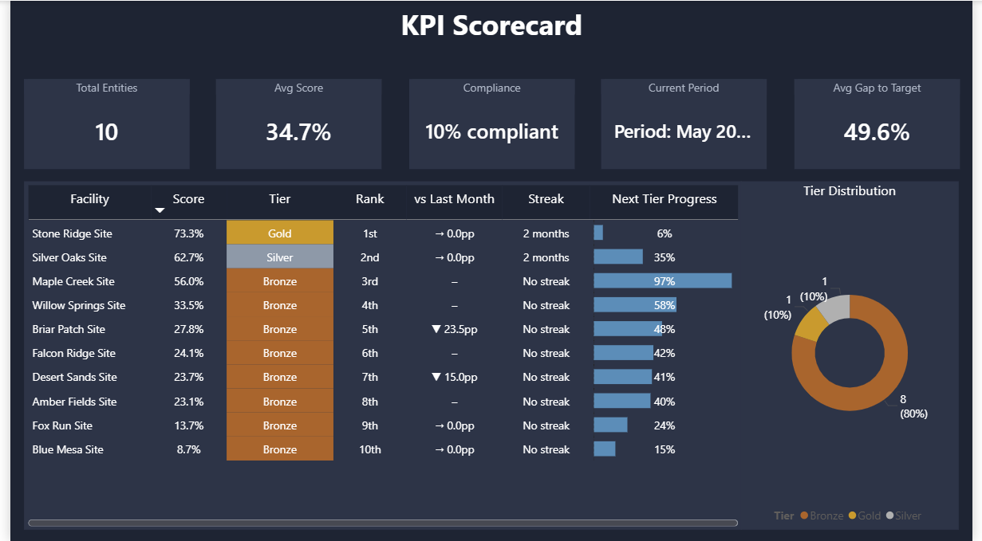
Data Governance Scorecard Dashboard
The report engine calculates facility scores from real submission and validation data, tracks performance tiers, and shows month-over-month trends — all configurable without code changes.
The data behind the templates are structured and consistent, which means users can ask plain language questions directly on top of it.
“Which facilities are declining?”
“What is driving the Bronze score at this site?”
“Which labs have the lowest acceptance rate this quarter?”
That's the AI readiness piece — clean governed data that an AI assistant can actually answer questions on.
Copyright EarthSoft Inc. 2026
earthsoft.com

Slide 28
Govern EQuIS® data for quality, traceability, and safe AI adoption​!
Key Takeaways

Slide 29
Six principles to govern AI-ready environmental data​
Governance principles: fit-for-purpose controls​
1
Authoritative source​
4
Risk-based controls​
Set EQuIS as system of record. Treat extracts and marts as derivatives. This prevents competing “truths” across reports, dashboards, and AI tools.​
Stricter review for compliance/decision outputs; lighter controls for exploratory work. Balances speed and defensibility.​
2
Traceability by design​
5
Least privilege access​
Require end‑to‑end lineage from intake to output; runs reproducible, timestamped. Replay and explain AI insights when challenged.​
Grant only the access needed for roles and tasks. Restrict edits, approvals, and exports for sensitive or high‑impact data. This reduces accidental leakage and unintended changes.​
3
Standard definitions​
6
Human accountability​
Use controlled vocabularies for locations, analytes, units, methods, and qualifiers. Apply the same definitions in ETL and analytics. Consistency reduces ambiguity in models and reporting.​
Assign owners for datasets, reference data, model approvals. Documented sign‑off for changes/releases. AI makes accountability explicit.​
Copyright EarthSoft Inc. 2026
earthsoft.com

Slide 30


earthsoft.com
Thank you

